Slide 1
CS 0449 Recitation 3
Gordon Lu

Slide 2
Plans for Today
Pointers
Pointer Arithmetic
Arrays and Pointers
String Manipulation
String Interning
Hints for the Lab
Structs

Slide 3
Concept Check

Slide 4
Question 1:

Slide 5
The correct answer is A!
Why?
C will check if the value passed into the conditional evaluates to zero or not.
If the value evaluates to 0, the statement will be interpreted as false!
Anything that is not zero will evaluate to zero!
In this case, we’re checking if -1 == 0! Since it does not, our condition is true!

Slide 6
Question 2:

Slide 7
The correct answer is B!
Why?
It’s the same idea as the first question, but we’re passing in 0!
Since 0 == 0, our statement evaluates to false, so we evaluate the code that falls in the else!

Slide 8
Question 3:

Slide 9
The correct answer is D!
Wait this doesn’t make any sense!!!
Well, it turns out that printf() will return the count of characters passed in!
Since, we passed in what’s up?\n, which has a count of 11 characters, printf() will return 11!
Then we evaluate the conditional statement, we’ll try to do (1 &&11).
1 && 11 will evaluate to 11. In fact, it turns out if we did (1 && 2 && 3 && 11) we would still get 11 back!
Generally:
AND returns the first false value or the last value if none were found.
OR will return the first true value!
Our result will turn out to be that, we will call the printf() function, and evaluate the conditional, so we end up getting what’s up printed to our console!

Slide 10
Question 4:

Slide 11
The correct answer is B!
Why?
First, ptr1 will point to the first element of our array, which is 1.
Then ptr2 will be ptr1 progressed by 3 positions, so we move up 3 positions in our array, which will result in ptr2 pointing to the 4th element of our array!

Slide 12
Question 5:

Slide 13
The correct answer is B!
Why?
Up to the line with ptr2, this code is identical to the previous question.
The only difference is we decrement our ptr2 two elements back, which would bring us to the 2nd element in our array, which, when dereferenced will yield 2.

Slide 14
Question 6:

Slide 15
The correct answer is B!
This is a tricky question to understand, but understanding why it is B, is the first step in understanding pointers!!
First, we attain a void pointer that points to our x variable.
Then, we mutate the value that the pointer points to, this in effect modifies the original x variable’s value as well!
(Technically, I would need a cast to a float pointer to actually change the value, but this gets the idea around) What change would I need to do to make this code compile??

Slide 16
Question 7:

Slide 17
The correct answer is A!
Why?
This follows a similar idea to the previous question, but we’re just combining some concepts together!
First, we move our pointer to the 3rd element, then we modify the array element value using the pointer to 12.2
Then, we print the value out, giving us 12.2

Slide 18
Question 8:

Slide 19
The correct answer is B!
More on this later!!

Slide 20
Question 9:

Slide 21
Question 10:

Slide 22
The correct answer is B!
Why?
First, vp will be off of the array, however it’s still pointing to SOMEWHERE IN MEMORY, we just don’t know what that is!
Then, vp_2 will point to the 4th element of the array!
Then, vp_3 will get a pointer to the 2nd element of the array!

Slide 23
Pointers

Slide 24
Memory
Before we talk about what pointers are… it’s helpful to understand memory a little more!
Memory is …. a huge one-dimensional array of bytes
Every byte has an associated address
That address is its array index
For values bigger than a byte, we scale up, and use consecutive bytes!
But… regardless of size, the address of any value is the address of the first byte!

Slide 25
The sizeof() function
sizeof() is a compile-time operation which tells you how many bytes something takes up!
EXTREMELY IMPORTANT:
C does not know how big an array of a pointer is!!
All pointers in C will be 8 bytes.
Repeat after me: NEVER INVOKE SIZEOF ON A POINTER
ANOTHER THING:
sizeof(array) GIVES YOU THE BYTE SIZE!!

Slide 26
Pointers: An Analogy

Slide 27
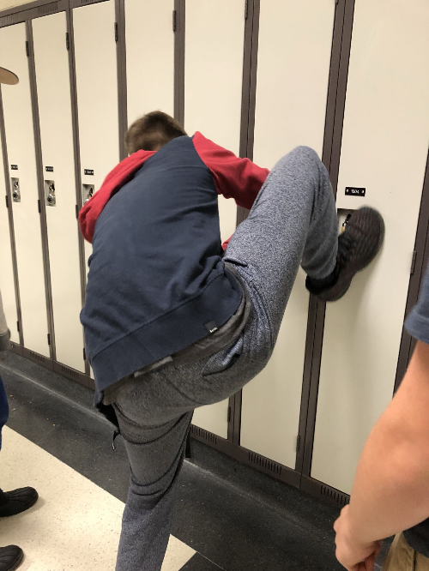
Lockers
1) Let’s think about lockers… what’s its purpose?
… to store things…
2) How do we identify lockers from one another?
Using their locker numbers…
3) How do you access a locker?
By knowing the locker number and combination….
For our purposes, let’s assume the lockers are combo-less
4) If I wanted to give someone else access to my locker, what would I do?
RIP IT OUT AND HAND IT TO THEM!
Hehe… ya just give them the locker number!

Slide 28
Locker Rooms
Just like a locker stores things
A variable stores things…
But a variable is a thing itself…
Each variable is just like a locker!
It has a number: its address
It stores something: its value
It belongs to someone: its owner
How would I give someone else access to my variable?
Give’m the locker number…
Which is… the memory address!
So what’s a variable?
It’s just a way to conveniently refer to their memory address!

Slide 29
Pointers!!!
A pointer is a variable which holds another variable’s memory address.
Once you have a pointer, you have access to two things:
The pointer itself
The variable it points to

Slide 30
Pointers

Slide 31
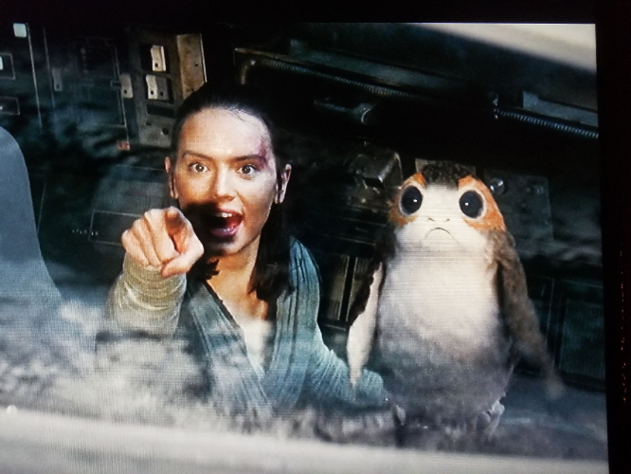
What is a Pointer?
A pointer is a variable that holds a memory address of another variable.
Essentially, anytime you would use an array in Java, you’d use a pointer in C.
You can access a value a pointer points to using the dereference operator (*).
C uses pointers because it’s easier to say, “that’s the place that has that data” rather than saying “This is the entire thing that which includes the data I’m interested in!”

Slide 32
Another thing… Arrays don’t Exist in C!
Wait… what???
You heard me… ARRAYS DON’T EXIST IN C
Basically, arrays are considered as local variables in C.
Meaning, we can’t return an array in C!
So, what do we do instead?
We return a pointer to the array instead!
BIG POINT: Arrays become pointers when passed into functions!

Slide 33
Address-OF (&) Operator
You can get the address of a variable via the address-of operator (&)
int x;
int* p = &x;

Slide 34
Pointers Example
int x = 10;
int y = 20;
int* p = &x;
We say “p points to x”
10
x
20
y
address of x
p

Slide 35
Pointers Example
p = &y;
int** pp = &p;
10
x
20
y
address of x
address of y
p
address of p
pp

Slide 36
Pointers and Arrays

Slide 37
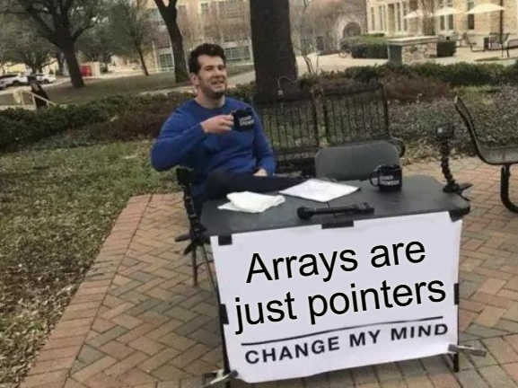
Pointers and Arrays
A pointer can point to one or more values.
A char* may point to a single char, or to an array of chars.

Slide 38
Arrays Example
char c = ‘x’;
char* s = &c;
s = “hi!”;
“Pointing to a single value” is the same as “pointing to an array of length 1”!
‘x’
c
address of c
address of
string literal
s
‘h’ | ‘i' | ‘!’ | ‘\0’

Slide 39
Accessing the Value at a Pointer

Slide 40
The Value-At (Dereference) Operator
1) * is the value-at operator: it’s the inverse of &
Every time you use it, you remove a star.
2) It accesses the variable that a pointer points to
We say that it “dereferences” a pointer

Slide 41
Pointer Example
int x = 10;
int* p = &x;
*p = 15; //changes x!
Changing the value of a pointer (via dereference) will change the original value!
10
x
15
address of x
p

Slide 42
Array-Indexing Operators

Slide 43
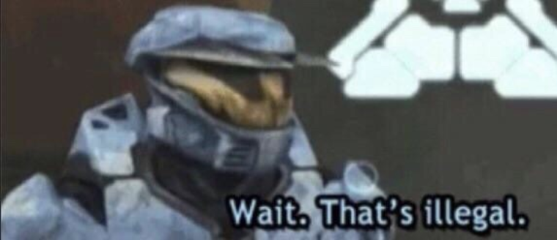
The Array Indexing Operator
p[n] means “access the nth item pointed to by p.”
char* s = “hi!”;
char c = s[2];
char d = 2[s];
Now c and d are the same thing…
address of
string literal
s
‘h’ | ‘i' | ‘!’ | ‘\0’

Slide 44
What the Brackets Actually do
p[n] in C really means “dereference address p + n”
s[2]
= *(s+2)
= *(2+s)
= 2[s]
What about values bigger than a char?

Slide 45
Scaling
When we add an offset to a pointer, the offset is multiplied by the size of the item being pointed to before being added to the base address.
For int pointers, we scale by 4.
int arr[3] = {1, 2, 3};
int* p = arr;
*(arr + 1) $→$ *(arr + 1*sizeof(int)) $→$ *(arr + 4)

Slide 46
Pointer Arithmetic & Void Pointers

Slide 47
Memory Addresses are just Numbers
1) Pointers hold memory addresses…
Memory addresses are just numbers.
2) It’s incredibly useful to do arithmetic on memory addresses
No dereferencing is involved in pointer arithmetic.
We are operating on the pointer itself!

Slide 48
Strings in C

Slide 49
Strings are just Char Arrays
Strings are just sequences of characters!
In C, we indicate the end of a String using a NULL TERMINATOR: ‘\0’
If we lose track of the NULL TERMINATOR, we’re pretty much screwed.

Slide 50
Strings in C
The end of a string is indicated by a NUL Terminator (‘\0’)
There are two ways to initialize strings in C, by a char array, or a char pointer
1) char mystr[100] = “hello”;
Allocates space for 100 characters, fills array with characters up to the length of the string, and fills the rest of the slots with ‘\0’!
2) char* mystr = “hello”;
Allocates the string in the static data segment
Allocates space for the pointer
Don’t do this if you want to do String Manipulation!

Slide 51
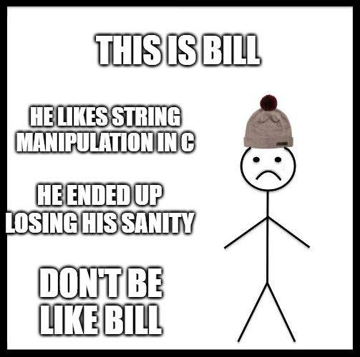
Basic String Functions
strlen(): Scans entire string for a ‘\0’ and return count of iterations to get there
strcmp(): compares two string and returns comparison value (compareTo in Java)
strcpy(a,b): copies string from b into memory at a
strcat(a,b): copies string from b into memory AFTER a.
Avoid string manipulation at ALL COSTS in C!!

Slide 52
String Manipulation Example
Suppose we start out with a char array mystr: char mystr[100];
mystr
If we strcpy the string, “this” into mystr:
mystr
If we strcat the string, “ is” into the modified mystr:
mystr
0 | 1 | 2 | 3 | 4 | 5 | 6 | 7 | 8 | 9
0 | 1 | 2 | 3 | 4 | 5 | 6 | 7 | 8 | 9
t | h | i | s | \0
0 | 1 | 2 | 3 | 4 | 5 | 6 | 7 | 8 | 9
t | h | i | s |  | i | s | \0

Slide 53
String Interning

Slide 54
Have you ever wondered….
I have the following code:
String s1 = “449”;
String s2 = new String(“449”);
s1==s2 //returns false!!

Slide 55
Memory Pools
Here’s what’s actually going on in the background:
s1 points to a pool of memory referred to as: “Non-heap Memory Pool”
s2 points to a pool of memory referred to as: “Heap Memory Pool”
So, when we compare s1 == s2, this returns false because the pointers are pointing to different memory pools

Slide 56
String Interning
How would we get around this?
String interning
We can forcefully make the pointer pointing to the Heap Memory Pool point to the Non-Heap Memory Pool.
This will work:
s1 ==s2.intern() //returns true

Slide 57
Hints for the Lab

Slide 58
Hints on the Size Puzzles
You need to consider the distances between adjacent array elements
Compare the addresses
Remember, an int* is an int pointer because it points to an address that may contain a value that is an integer
Addresses can exceed 32 bits, what’s a decimal number that is > 32 bits?

Slide 59
withinSameBlock
Problem:
Determine if the addresses stored by two pointers lie within the sameblock of 64-byte aligned memory
Idea:
Consider the upper 26 bits
Compare the upper 26 bits of ptr1 and ptr2

Slide 60
Example 1
ptr1: 0x0 $→$ 0000 0000
ptr2: 0x3F $→$ 0011 1111
return 1

Slide 61
Example 2
ptr1: 0x0 $→$ 0000 0000
ptr2: 0x40 $→$ 0100 0000
return 0

Slide 62
Example 3
ptr1: 0x3F $→$ 0011 1111
ptr2: 0x40 $→$ 0100 0000
return 0

Slide 63
Example 4
ptr1: 0x3CE $→$ 0011 1100 1110
ptr2: 0x3EF $→$ 0011 1110 1111
return 1

Slide 64
Example 5
ptr1: 0x3CE $→$ 0011 1100 1110
ptr2: 0x404 $→$ 0100 0100 1111
return 0

Slide 65
withinArray
Problem:
Determine if the address stored in ptr pointing to a byte that makes up some part of an array element for the passed array
Idea:
Consider the upper 32-size bits
Compare the upper 32-size bits of intArray and ptr
Idea 2:
Consider the distance between the last element and ptr
Consider the distance between the first element and ptr
Signs should not differ if pointer points to element in the array

Slide 66
stringSpan
Problem:
Returns the length of the initial portion of str1 which consists only of characters that are part of str2.
The search does not include the terminating null characters of either strings but ends there.
String 2 is basically an alphabet, and the moment we have a match with a character in String 1, we continue to search through String 1 until a character in String 1 is not in String 2.

Slide 67
stringSpan Ideas
Idea 1: Hit Table
Every character has a corresponding ASCII value (256 for extended)
Scan through all the characters the second string, mark the corresponding ASCII value in the table if seen
Scan through the first string, once we get a mismatch, return the iteration variable

Slide 68
stringSpan Ideas
Idea 1: Brute-Force
Initialize j = 0, count = 0;
For the current character in String 2:
Loop through the characters in String 1:
if str1 + j == str2
cnt++
else
break
j++
str2++

Slide 69
Example 1
stringSpan(abcde, ac)

Slide 70
Example 2
stringSpan(123456, ab)

Slide 71
Example 3
stringSpan(hello, hel)

Slide 72
Example 4
stringSpan(abcdefgh, abXXcdeZZh)

Slide 73
Questions?

Slide 74
Extra Practice

Slide 75
Question 11:

Slide 76
Question 12:

Slide 77
Question 13:

Slide 78
Question 14:

Slide 79
Question 15:

Slide 80
Question 16:

Slide 81
Question 17:

Slide 82
Question 18:

